Slide 1
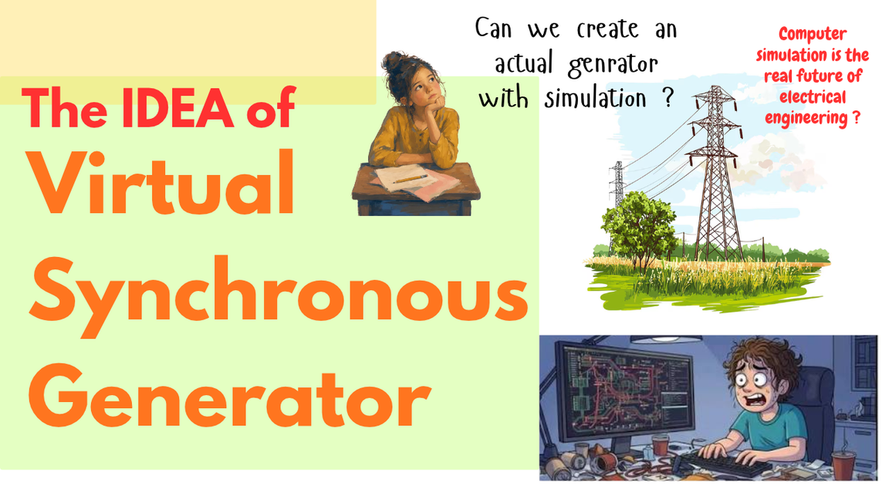

Slide 2
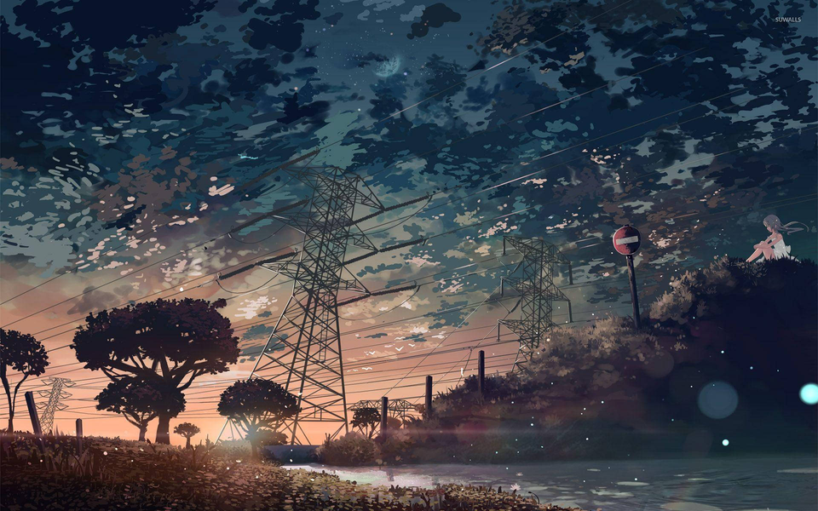
Presentation on
The synchronization of the solar energy with the gird and virtual synchronous generators
By -
Nikhil Kushwah
B.Tech, 7th Sem , EE
SATI Vidisha (M.P.)
E-Mail : nikhilkushwah078@gmail.com

Slide 3





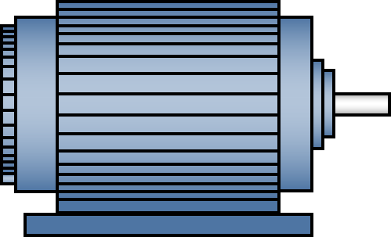
Synchronization of two electrical generators
How can we control the power transfer form the generator to the grid ?
15MW
15MW
20MW
10MW
If we reduce the power generation of the generator 2 then how would the generator 1 know that ?
Generator 1
90MW
Generator 2
10MW
Load
30MW
To understand the power controlling of the synchronous generator Swings equation and Power Angle Equation.

Slide 4
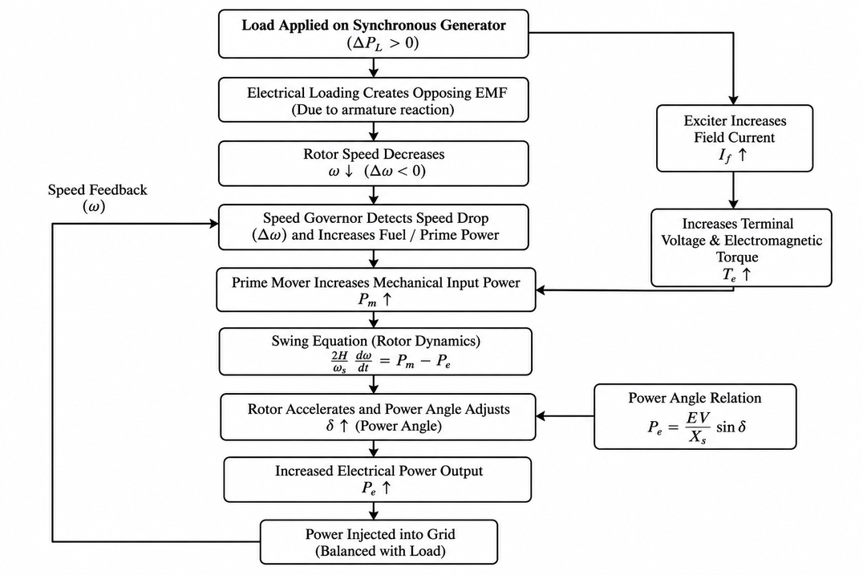
Electrical loading and governing of synchronous generator

Slide 5

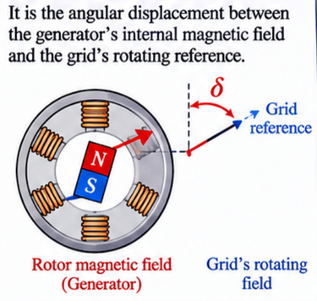
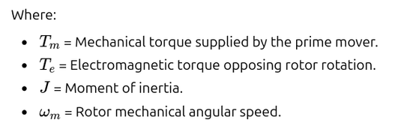

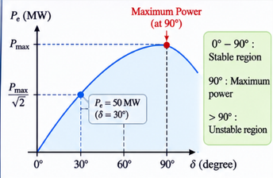
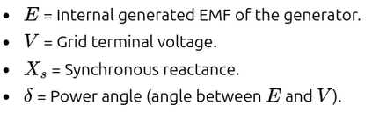
Power transfer and control of synchronous generators
Swings Equation -
This equations give us the relation that how the electrical loading after the rotor speed
This equation tell us that how we can control the power transfer of the generator using Power Angle

Slide 6
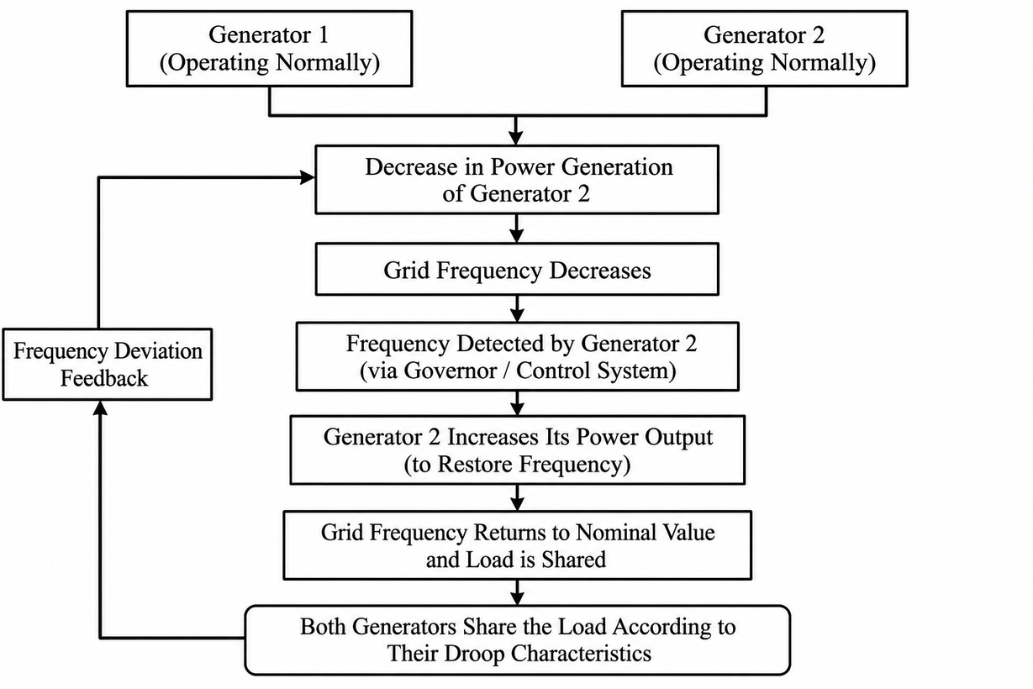

Slide 7
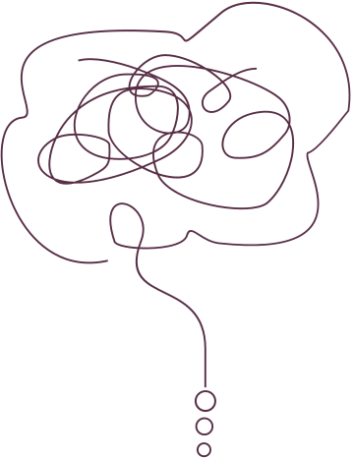

But how would the generators know that how much energy they have to produce ?
or who decide that which generator need to generate how much of electricity ?
To understand it we have to understand the Droop Equations of the synchronous generators ?

Slide 8
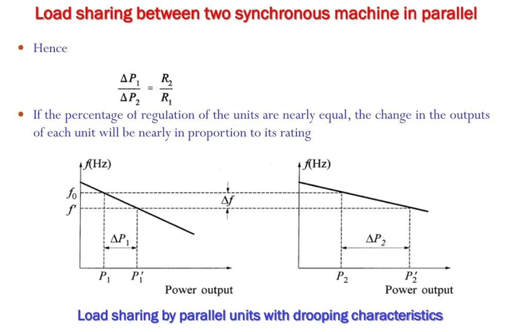
Droop Equations / Characteristics -
The Droop characteristics provide a way for multiple generators to automatically share an increasing electrical load without requiring continuous communication between them.
The droop characteristics of a synchronous generator are primarily determined by the settings and design of its governor control system rather than by its manufacturing date or the connected electrical load. The governor controls the mechanical input supplied to the prime mover (such as steam, water, or fuel) according to changes in system frequency.Engineers configure the governor's droop setting during commissioning

Slide 9
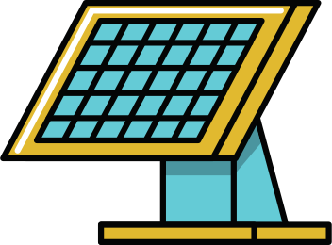
What happen in the case of only solar generating plants
Suppose both the inverter operate at the constant frequency 50hz and synchronized to each other
Now here the big question is that the solar inverters do not have any actual rotating rotor it means the frequency not decrease when the load increased on the grid and if the frequency is not decreasing then then is not any droop characteristics exists then how does the each plant or inverter know that how much power they have to generate independently without communicating to each other.
15MW
15MW
10MW
inverter 1
90MW
Inverter 2
10MW
Load
30MW
To solve this problem we have an technology name Virtual Synchronous Generator

Slide 10
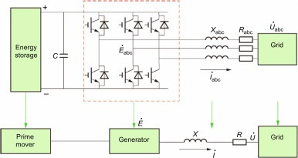
Virtual Synchronous Generator
A Virtual Synchronous Generator (VSG) is a software-based control technique that uses mathematical algorithms to emulate the dynamic behaviour of a conventional synchronous generator, including inertia, damping, and power-angle characteristics. It enables inverters to respond to grid frequency variations like synchronous generators and implement frequency-power droop control, allowing multiple inverters to share electrical loads automatically while improving grid stability.
The virtual generator has the battery storage system to recreate the rotor inertia in the gird

